Slide 1

Bank Performance Analysis Dashboard
Power BI Portfolio Project
Prepared by: Sunday Obioma
Analysis Period: January – June 2025
Tools Used: Power BI, Power Query, DAX, Microsoft Excel

Slide 2







Dataset Description
Dataset: Bank Performance Dataset
Period: January – June 2025
Branches: 50
Main Fields: Branch, Revenue, Expenses, Profit, Loans Issued and Date
Source: Simulated banking dataset created for portfolio demonstration
Rows: 300 records

Slide 3
Data Preparation
Imported the banking dataset into Power BI
Cleaned and transformed the data using Power Query
Validated
data types, missing values, and inconsistencies
Created calculated measures and KPIs using DAX
Prepared the data model for analysis and visualisation

Slide 4
Key Performance Indicators (KPIs)
Total Revenue - Measures the bank’s overall income generated during the analysis period
1
Total Expenses - Shows operating costs incurred across the branches
2
Total Profit - Indicates the bank’s overall financial performance
3
Total Loans –Issued
Measures the value of loans issued during the period
4
Total branches- Shows the number of branches
5

Slide 5
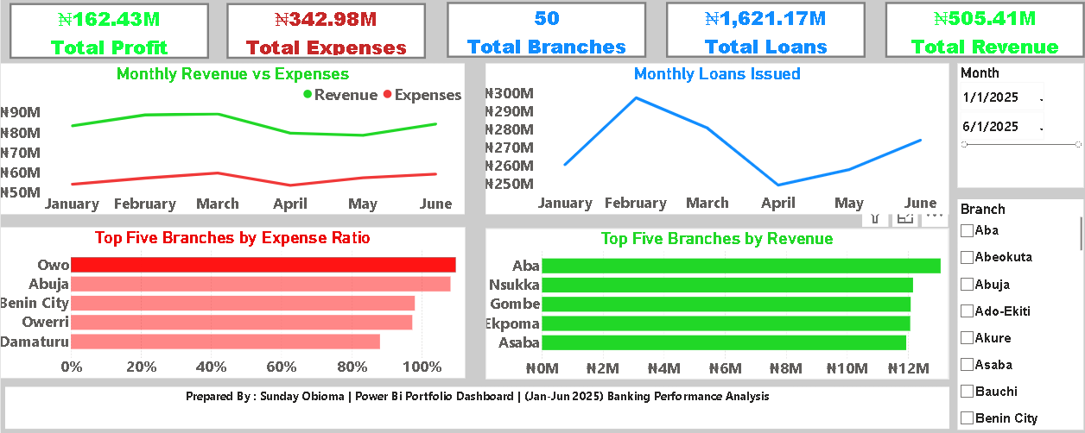
Dashboard & Visual Analysis
₦1,621.17M
Total Loans Issued
Power BI dashboard for monitoring financial performance, branch efficiency, revenue, expenses, and loan activity

Slide 6
Key Business Insights
Revenue exceeded expenses, generating a total profit of ₦162.43M during the six-moth period.
Revenue peaked in the first quarter, reaching about ₦84M monthly, before declining noticeably from April
Loan issuance was highest in February at approximately ₦293M, but fell sharply in April before recovering in June
Aba recorded the highest revenue, followed by Nsukka, Gombe, Ekpoma, and Asaba
Owo, Abuja and Benin City recorded the highest expense ratios, highlighting branches where cost efficiency should be reviewed, particularly Owo

Slide 7
Recommendations
Improve
Improve cost control at branches with high expense ratios, particularly Owo, Abuja, and Benin City
Investigate
Investigate the factors behind Owo’s high expenses and implement measures to improve its profitability
Strengthen
Strengthen revenue-generating activities at high-performing branches such as Aba, Nsukka, Gombe, Ekpoma, and Asaba
Review
Review loan issuance trends and investigate the sharp decline in April to identify factors affecting loan demands or disbursement
Monitor
Monitor branch performance regularly using the Power BI dashboard to support timely, data-driven decisions

Slide 8
Conclusions
The analysis showed that the bank remained profitable during the January-June 2025 period with revenue exceeding expenses
Branch performance varied considerably , with a few branches contributing strongly to revenue, while others showed higher cost ratios
The analysis identified opportunities to improve cost efficiency , strengthen revenue generation, and monitor loan performance
The Power BI dashboard provides an interactive tool for monitoring KPIs and supporting data-driven branch management

